Slide 1
Population Management System Website Project – Cambodia: Empowering Commune-Level Data Administration
Enhancing local data management and administrative efficiency
Notes:
AI-generated content may be incorrect. --- This presentation introduces the Population Management System website project for Cambodia, designed to enhance data administration at the commune level. We will explore the project's objectives, key features, technology stack, architecture, and deployment strategies.

Slide 2
Meeting Program
Project Overview
Key Modules and Features
Technology Stack
System Architecture
Database Schema Overview
Folder Structures (Frontend and Backend)
Multi-Tenancy and Access Control
Reporting and Analytics
Deployment Strategy
Notes:
We will cover an overview of the project, its key modules, the technology stack used, the system architecture, database design, folder structures, security models, reporting tools, and deployment strategies.

Slide 3
Project Overview
Notes:
This section outlines the purpose and objectives of the Population Management System, identifies the target users at the commune level, and discusses the project scope along with its anticipated impact on population data administration in Cambodia.

Slide 4
Project Purpose and Objectives
Streamlining Data Management
The project focuses on modernizing population data management for enhanced efficiency and accuracy.
Facilitating Data Entry
Facilitating easy and accurate data entry to keep population records up to date.
Empowering Local Authorities
Empowering local authorities to use accurate data for effective decision-making at commune levels.
Notes:
--- The project aims to streamline and modernize population data management, improve accuracy, and empower local authorities. The objectives include facilitating data entry, updating records, and enabling effective decision-making at commune levels. Image source: Microsoft 365 content library

Slide 5
Target Users: Commune-Level Authorities
Primary User Group
Commune-level officials are the main users responsible for managing local population data and administration.
System Usability
The system is designed to fit their specific workflows, improving ease of use and efficiency in daily tasks.
Data Accuracy and Governance
Enhanced data accuracy supports better decision making and governance at the local level.
Notes:
--- The primary users are commune-level officials responsible for population administration. The system is tailored to their workflows to enhance usability and data accuracy, ensuring efficient local governance. Image source: Microsoft 365 content library

Slide 6

Scope and Anticipated Impact
Comprehensive Data Coverage
The system manages population records and identity documents integrating multiple national databases for unified access.
Enhanced Data Reliability
Improving accuracy and consistency of data to support administrative decision-making and public services.
Support for National Development
The system supports Cambodia’s development goals by streamlining administration and enabling better planning.
Notes:
--- The system covers population records, identity documents, and integrates with national databases. It aims to improve data reliability, administrative efficiency, and support Cambodia’s national development goals. Image source: Microsoft 365 content library

Slide 7
Key Modules and Features
Notes:
This section presents the main functional components of the system, focusing on legislation management, family and residential records, identity cards, death registrations, and integration with national communal databases.

Slide 8
Legislation Ledger Management
Tracking Population Laws
The module tracks relevant population laws and regulations to ensure all legal requirements are monitored consistently.
Ensuring Compliance
It facilitates compliance with population legislation by managing updates and aligning with current legal standards.
Legislation Updates
The system supports seamless updates to legislation affecting population data management to keep information current.
Notes:
--- Enables tracking and management of relevant population laws and regulations. This module ensures compliance and facilitates updates to legislation affecting population data management. Image source: Microsoft 365 content library

Slide 9
Family Book and Residential Card Modules
Family Unit Data Management
Modules facilitate detailed management of family unit information for accurate household records.
Residential Card Issuance
Modules handle issuance and tracking of residential cards ensuring organized identification at local levels.
Commune Level Organization
These systems support accurate and systematic household record-keeping at the commune administrative level.
Notes:
--- These modules manage family unit data and residential card issuance, allowing for accurate and organized household records at the commune level. Image source: Microsoft 365 content library

Slide 10

National SIM Identity Card and Death Registration
SIM Identity Card Management
Facilitates the issuance and management of national SIM identity cards ensuring secure and verified user identification.
Accurate Death Registration
Ensures accurate and timely registration of deaths to maintain reliable and updated population data.
Notes:
--- Supports the issuance and management of national SIM identity cards and the accurate registration of deaths to maintain up-to-date population records. Image source: Microsoft 365 content library

Slide 11

Integration with NCDD Cambodia Communal Database
Seamless Data Exchange
Integration enables smooth and uninterrupted exchange of data with the communal database for improved communication.
Data Synchronization
Synchronization ensures that data is consistently updated across systems, reducing errors and discrepancies.
Enhanced Data Reliability
Reliable integration supports accurate and trustworthy data management across platforms.
Notes:
--- Ensures seamless data exchange and synchronization with the National Committee for Sub-National Democratic Development's communal database, enhancing data consistency and reliability. Image source: Microsoft 365 content library

Slide 12
Technology Stack
Notes:
This section covers the technologies used for building the frontend, backend, and databases, highlighting the modern tools chosen to ensure robustness, scalability, and ease of maintenance.

Slide 13

Frontend: Next.js, React TSX, Shadcn UI, Tailwind CSS
Next.js Framework
Next.js enables server-side rendering and static site generation for optimized React applications.
React with TSX
React combined with TSX ensures component-based UI with type safety for better code quality.
Shadcn UI Components
Shadcn UI provides customizable and reusable UI components to speed up frontend design.
Tailwind CSS Styling
Tailwind CSS offers utility-first styling for rapid and responsive frontend development.
Notes:
--- The frontend is built using Next.js and React with TSX for type safety, styled with Shadcn UI components and Tailwind CSS for rapid and responsive UI development. Image source: Microsoft 365 content library

Slide 14

Backend: Node.js TSX, PHP 4.x Native, Python 3.12.7
Node.js with TSX
Node.js with TSX powers modern server-side logic and enables efficient handling of asynchronous operations.
Legacy PHP 4.x Components
Legacy PHP 4.x components maintain existing integrations and support older backend functionalities.
Python 3.12.7 for Processing
Python 3.12.7 handles specialized processing tasks and supports advanced backend operations.
Notes:
--- The backend incorporates Node.js with TSX for modern server-side logic, legacy PHP 4.x components for existing integrations, and Python 3.12.7 for specialized processing tasks. Image source: Microsoft 365 content library

Slide 15

Databases: MySQL, PostgreSQL, MongoDB
MySQL and PostgreSQL
MySQL and PostgreSQL are relational databases used for structured data storage with strong consistency and ACID compliance.
MongoDB for Document Storage
MongoDB provides flexible, scalable document-oriented storage suited for unstructured or semi-structured data.
Notes:
--- Multiple databases are utilized, including MySQL and PostgreSQL for relational data storage, and MongoDB for flexible document storage, ensuring optimized data management. Image source: Microsoft 365 content library

Slide 16
System Architecture
Notes:
This section explains the overall system design, including diagrams, module interactions, data flows, and integration points with external systems to deliver a cohesive solution.

Slide 17

High-Level Architectural Diagram
System Components Overview
The diagram visually represents major system components and their interactions.
Data Flow Illustration
Shows how data moves between frontend, backend, databases, and external systems.
Control Flow Representation
Illustrates control signals and coordination among system parts for processing tasks.
Notes:
--- Provides a visual representation of system components and their relationships, illustrating how data and control flow between frontend, backend, databases, and external systems. Image source: Microsoft 365 content library

Slide 18

Module Interactions and Data Flows
Module Communication
Modules communicate internally through defined interfaces to ensure coherent operations and data sharing.
Data Processing Sequence
Data processing follows a sequence of steps that preserves data integrity and ensures timely responsiveness.
Maintaining System Integrity
System integrity is maintained by validating data at each processing stage and handling errors effectively.
Notes:
--- Details how different modules communicate internally and the sequence of data processing steps to maintain integrity and responsiveness. Image source: Microsoft 365 content library

Slide 19

Integration Points with External Systems
Interfaces and APIs
Interfaces and APIs enable seamless communication between internal and external third-party systems for data exchange.
Third-Party Integration
Integration with external systems like communal databases ensures up-to-date and synchronized population data.
Notes:
--- Describes interfaces and APIs enabling communication with third-party systems like the NCDD communal database to ensure synchronized and up-to-date population data. Image source: Microsoft 365 content library

Slide 20
Database Schema Overview
Notes:
This section presents the design of the database schema, focusing on entity relationships, key tables, and data normalization to maintain data quality and integrity.

Slide 21

Entity Relationship Diagrams
Representation of Entities
ER diagrams depict entities such as individuals, families, residences, and legal documents clearly within data models.
Relationships Between Entities
The diagrams show how different entities relate to each other, aiding in understanding data structure and connections.
Clarity in Data Structure
ER diagrams provide clarity by visually mapping complex relationships within data systems for better comprehension.
Notes:
--- Shows the relationships between entities such as individuals, families, residences, and legal documents to provide clarity on data structure. Image source: Microsoft 365 content library

Slide 22

Key Tables for Population Data
Population Records Storage
Critical tables store detailed population records vital for demographic analysis and planning.
Identity Information Management
Tables contain identity information essential for accurate citizen identification and verification.
Registration Data Handling
Registration data tables support commune-level management through organized data collection and storage.
Notes:
--- Highlights the critical tables that store population records, identity information, and registration data essential for commune-level management. Image source: Microsoft 365 content library

Slide 23
Data Normalization and Integrity
Reducing Data Redundancy
Normalization minimizes duplicate data, optimizing storage and improving database efficiency.
Ensuring Data Consistency
Normalization maintains data accuracy and uniformity across the database tables.
Securing Data Reliability
Normalization processes support reliable data retrieval and trustworthy information management.
Notes:
--- Explains the normalization processes applied to reduce redundancy and ensure consistency, securing the reliability of stored data. Image source: Microsoft 365 content library

Slide 24
Folder Structures (Frontend and Backend)
Notes:
This section reviews the organization of codebases for both frontend and backend components, emphasizing maintainability and scalability.

Slide 25

Frontend Folder Organization (Next.js & React)
Components Folder
Holds reusable UI components to promote modularity and maintainability in frontend codebases.
Pages Folder
Contains page-level components that define routes and layout structure within the application.
Styles Folder
Stores CSS or styling files to maintain consistent design across the application.
Utilities Folder
Includes helper functions and utilities that support application logic and code reuse.
Notes:
--- Describes the modular folder layout for components, pages, styles, and utilities to facilitate clean and efficient frontend development. Image source: Microsoft 365 content library

Slide 26
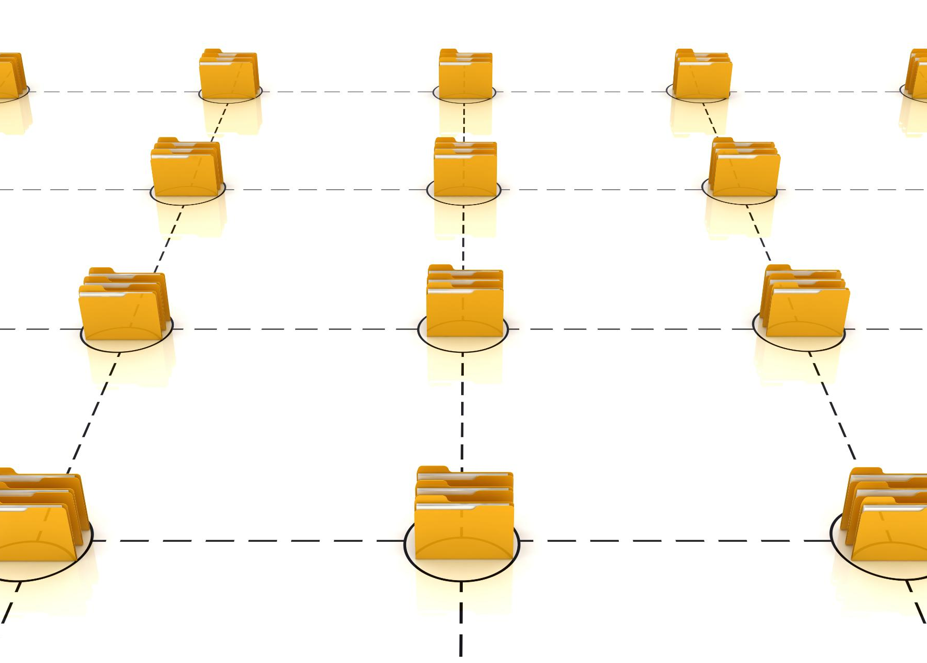
Backend Folder Organization (Node.js, PHP, Python)
Service Separation
Services are organized into distinct folders by language to improve maintainability and clarity in backend operations.
Script Management
Scripts are separated by programming language, helping developers easily locate and update code components.
Legacy Code Handling
Legacy code is stored in dedicated directories to prevent interference with current services and streamline updates.
Notes:
--- Details the separation of services, scripts, and legacy code across Node.js, PHP, and Python directories to enable streamlined backend operations. Image source: Microsoft 365 content library

Slide 27

Best Practices for Maintainability
Coding Conventions
Consistent coding conventions improve readability and simplify maintenance across development teams.
Documentation Standards
Clear documentation ensures understanding and ease of updates by current and future developers.
Modular Design Principles
Modular design breaks systems into manageable components, facilitating updates and scalability.
Notes:
--- Highlights coding conventions, documentation standards, and modular design principles implemented to ensure the long-term maintainability of the system. Image source: Microsoft 365 content library

Slide 28
Multi-Tenancy and Access Control
Notes:
This section focuses on how the system supports multiple communes and users with varying roles, ensuring secure and appropriate data access.

Slide 29

Multi-Tenancy Model for Communes
Data Isolation
The model ensures that each commune's data is securely separated from others, preventing cross-access.
Configuration Independence
Each commune can independently manage its settings and configurations without affecting others.
Secure Shared System
The architecture supports multiple communes operating securely on a single shared infrastructure.
Notes:
--- Explains the architecture that isolates data and configurations per commune, enabling secure and independent management within a shared system. Image source: Microsoft 365 content library

Slide 30

Role-Based Access Control Mechanisms
Role Assignment
Users are assigned specific roles that define their permissions within a system, ensuring organized access management.
Permission Enforcement
Role-based access control enforces security policies by restricting data access and modifications to authorized roles only.
Notes:
--- Details how user permissions are assigned based on roles to enforce security policies and prevent unauthorized data access or modifications. Image source: Microsoft 365 content library

Slide 31
Security Considerations
Data Encryption
Data encryption secures sensitive population data by converting it into unreadable formats to unauthorized users.
Authentication Protocols
Authentication protocols verify user identities to prevent unauthorized access to protected information.
Audit Logging
Audit logging tracks system activities to monitor security events and ensure data integrity.
Notes:
--- Reviews implemented security measures including data encryption, authentication protocols, and audit logging to protect sensitive population data. Image source: Microsoft 365 content library

Slide 32
Reporting and Analytics
Notes:
This section highlights tools and features that provide insights through dashboards, custom reports, and data visualizations for informed decision-making.

Slide 33
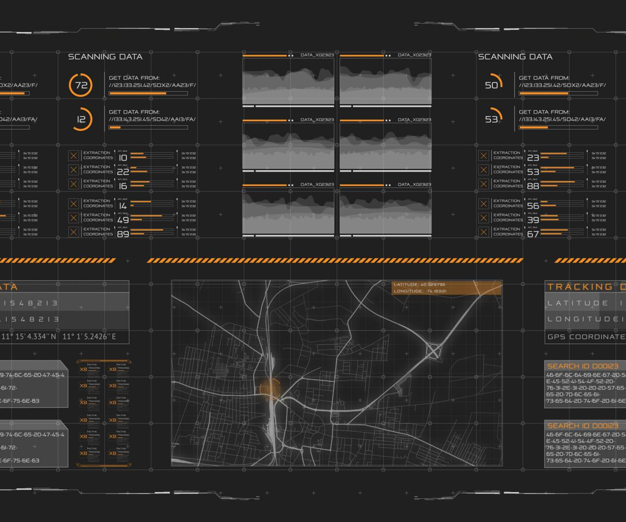
Population Statistics Dashboards
Real-time Population Data
Dashboards offer up-to-date statistics on population size and growth to support timely decision-making.
Demographic Trends Analysis
Visualization of age, gender, and other demographics helps identify social and economic trends.
Planning Support for Authorities
Accurate data aids commune authorities in resource allocation and community planning.
Notes:
--- Interactive dashboards provide real-time statistics on population demographics, trends, and other key metrics, aiding commune authorities in planning. Image source: Microsoft 365 content library

Slide 34

Custom Report Generation
Tailored Report Creation
Users create reports customized to specific data and criteria matching administrative needs effectively.
Efficiency in Reporting
Custom report generation streamlines administrative and government reporting processes, saving time.
Notes:
--- Users can generate tailored reports based on specific criteria to meet administrative and governmental reporting requirements efficiently. Image source: Microsoft 365 content library

Slide 35
Data Visualization Tools
Charts for Data Presentation
Charts help to visually display data trends and comparisons effectively for better understanding.
Graphs for Analysis
Graphs are used to illustrate relationships and patterns in complex datasets clearly.
Maps for Spatial Data
Maps visualize geographical distribution of data, aiding in spatial analysis and interpretation.
Notes:
--- Utilizes charts, graphs, and maps to visually present complex data, making it easier to interpret and analyze population information. Image source: Microsoft 365 content library

Slide 36
Deployment Strategy
Notes:
This section discusses the process and best practices for deploying the system, including pipeline automation, environment setups, and scalability considerations.

Slide 37

Deployment Pipelines and Environments
Automated Build Process
Automated pipelines compile and build code efficiently ensuring consistency across all environments.
Testing Environments
Testing environments validate code quality and functionality before deployment to production.
Deployment to Production
Code is deployed to production environments reliably using automated deployment pipelines.
Notes:
--- Covers the use of automated pipelines for building, testing, and deploying code across development, staging, and production environments. Image source: Microsoft 365 content library

Slide 38

Continuous Integration / Continuous Deployment (CI/CD)
Frequent Reliable Updates
CI/CD workflows enable frequent and reliable software updates to meet user needs quickly and efficiently.
Minimal Downtime
Deployment strategies in CI/CD minimize downtime, ensuring continuous application availability and smooth user experience.
Rapid Feedback Loops
CI/CD integrates testing and monitoring for rapid feedback, allowing quick detection and resolution of issues.
Notes:
--- Details the CI/CD workflows implemented to ensure frequent, reliable updates with minimal downtime and rapid feedback loops. Image source: Microsoft 365 content library

Slide 39

Scalability and Reliability Measures
Load Balancing
Load balancing distributes network traffic evenly to optimize resource use and prevent overloads.
Redundancy
System redundancy ensures backup components are available to maintain service during failures.
Monitoring
Continuous monitoring tracks system health and alerts to potential performance issues promptly.
Notes:
--- Describes strategies such as load balancing, redundancy, and monitoring to maintain system performance and availability as user demand grows. Image source: Microsoft 365 content library

Slide 40
Conclusion
Empowering Commune Authorities
The system equips local authorities in Cambodia with tools to manage population data effectively and efficiently.
Secure Data Management
The platform ensures secure handling and protection of sensitive population data through advanced technology.
Supporting National Goals
Improved population data administration supports Cambodia's broader national development and planning objectives.
Notes:
The Population Management System website project is a comprehensive solution designed to empower commune-level authorities in Cambodia. Through modern technology, secure data management, and user-friendly features, it aims to improve population data administration and support national development goals.

